Slide 1
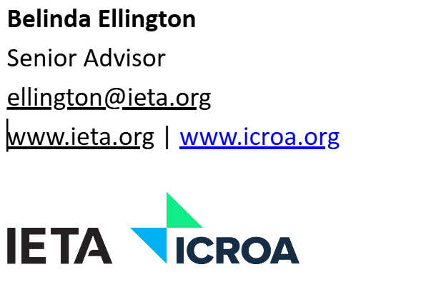


ADB Webinar 3: Legal Frameworks
Belinda Ellington
Legal Support Partner
www.ellingtonresolution.co.uk

Slide 2
Agenda: Legal Frameworks
Part 1: Project activity
Setting Strategy
Authorisations and Use case – Corresponding adjustments and LOA
Project approval
Fees, levies, taxes, share of proceeds
Safeguards and grievance mechanisms (WS2)
Ownership of Credits
Methodologies and MRV process
Investment and Contractual Law Protections
Disputes – arbitration and access to courts
Part 2 Market Activity
Who, what and how
Market Oversight and illicit activity
Case law
Enforcement

Slide 3
To attract and regulate finance for carbon projects, a host country must establish a comprehensive legal and regulatory framework that ensures
  clarity
  legal certainty
  accountability
Provide clear rules for
  credit issuance
  ownership
  benefit-sharing,
  safeguard environmental and social integrity
Balance between regulation and freedom of contracting parties

Slide 4
Strategy on use of credits – initial steps
1. Allocate responsibility within government
2. Strategy defines policy and policy defines legal frameworks
Central standalone OR cross departmental e.g.
Energy and infrastructure + agriculture and environment + financial and other regulators
  Main Oversight Office
  Rule making committees
  Expert panels
  Secretariat
Art 6 implementation
NDC targets – UN Oct 25
Conditional and Unconditional targets
How easy is it abate emissions cost effectively?
  Current source of emissions
  Costs of transition and available alternatives
  Availability of sinks
Carbon pricing mechanism
See world bank guidance and utilise support from crediting mechanisms and other countries
  MRV oversight
  Registry issues
  Infrastructure and operations
Tax
ETS
Boarder mechanism
Utilisation of credits within an ETS

Slide 5
Strategy on use of credits
National crediting program
Independent crediting program
Towards other NDC or OIMP (CORSIA or voluntary buyer with an “offsetting claim”)
Mitigation is sold to help another country meet its NDC
Credit must be a correspondingly adjusted
Voluntary purchasers making a “contribution claim” or HC domestic market
Mitigation remains on
own NDC
Credit does NOT need to be correspondingly adjusted
Balance between achieving own NDC targets and raising finance by selling mitigation outcomes
A6.4 ERs
A6.2 ITMOs
For domestic use
Leveraging voluntary markets
VCC
MCU
Mitigation contribution Unit

Slide 6
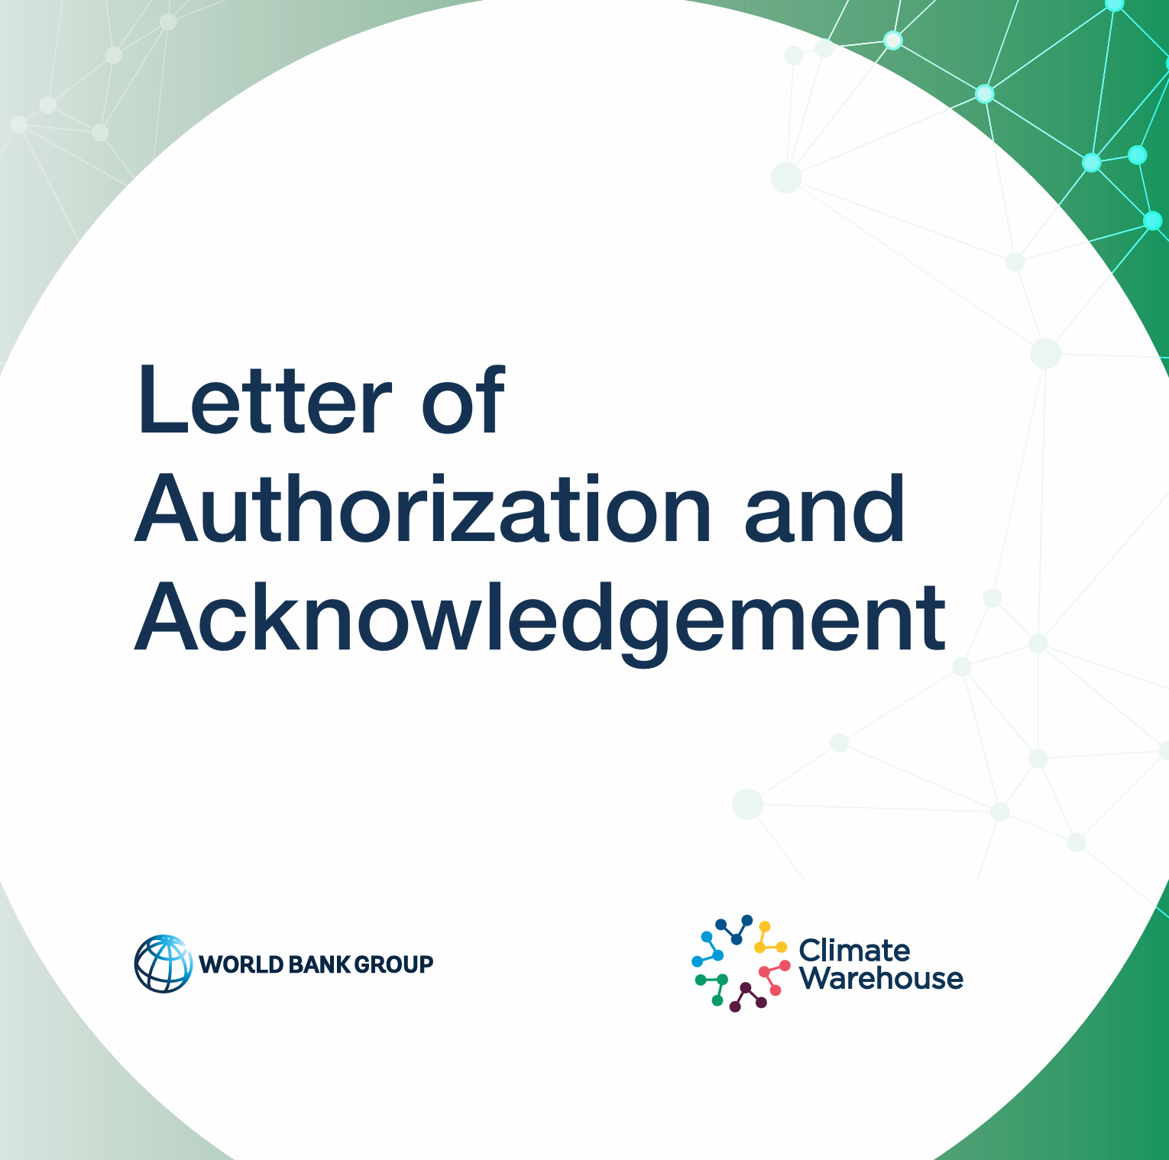
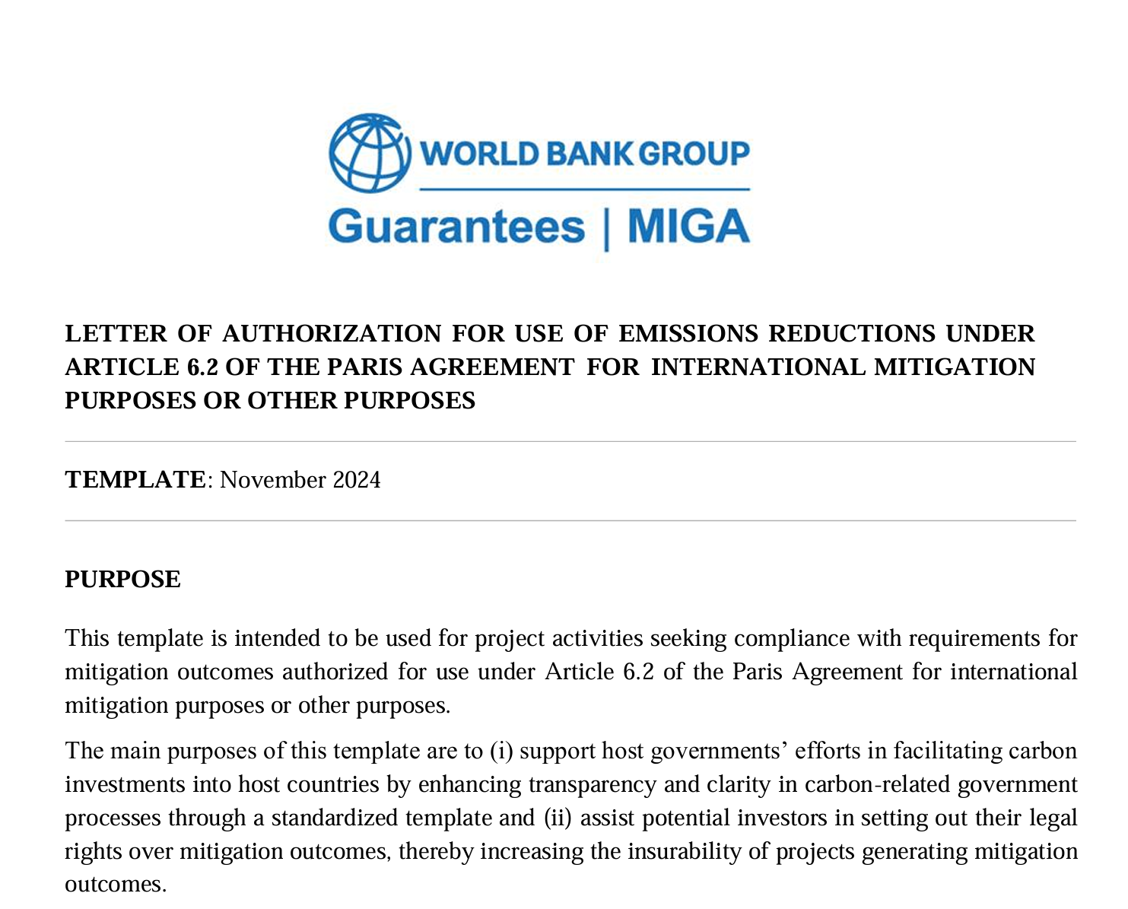
LOA and Corresponding Adjustments
Double counting occurs where more than one party (a country or private entity) counts a tCO2e abatement towards its target i.e. it reports an emissions footprint net of the relevant tCO2e represented by a VCC.
Double claiming occurs where more than one party makes a materially similar claim in respect of tCO2e abatement represented by a VCC.
The PA requires a country selling emissions reduction for use towards another country’s NDC (“ITMOS”) to make a corresponding adjustment to its own NDC, i.e. those reductions must be added back onto its own NDC.
Debate as to whether VCCs sold into the VCM need to be CA? – Depends on the reporting and claim made by buyer.
Letter of Authorisation Between Host Country And Project Developer And All transferees of credits
  Authorising Activity
  Authorising Use Case
  Conditions e.g.
    benefit sharing
    share of proceeds
    percentage of production only
    time period
  Insurance for revocation
  MIGA guarantee
  Private insurance

Slide 7

Legal Framework on project approval and registration process
Clear and transparent approval system – need a Designated National Authority
Project screening and approval protocols for project type and methodology
  Criteria for all activities including environmental integrity, technical and financial additionality, safeguards, FPIC, MRV criteria
  Approval of certain crediting programmes ie utilising their MRV cycle
  Or implementation of own crediting platform including domestic registry
  Activities and methodologies eligible or ineligible for CA
    E.g. Ghana
      Whitelist including landfill gas management, renewable energy technologies and sustainable cookstoves eligible for CA
      Red List of activities that will not be CA ie used towards own NDC including certain REDD+, fuel switching and urban transit programmes
      Other activities may apply on a case-by-case basis
      Framework for voluntary carbon units not requiring CA but still requiring registration and authorisation of the activity
Clear framework for revocation or suspension including breach of LOA

Slide 8
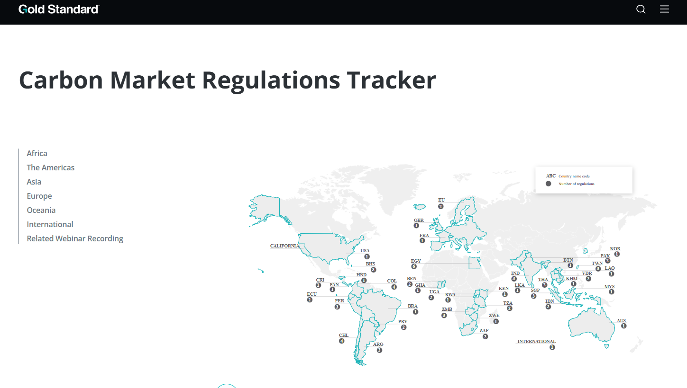
Examples
 | Framework
Application process | Relevant Authority/ies Agriculture/Industrial/Energy/Conservation
Requirements for approval General and specific with definitions Additional – baselines and accounting protocols Independent verification Permanent Do no harm No Leakage | Activity details – draft methodology Location and land rights Recognised Crediting program and authorised VVB Parties – KYC Volumes and periods EIA Stakeholder consultation report Permanence risk assessment Co-benefit report Objective for credits – CA or voluntary Insurance
Suspension, termination, modification | Violations, non-compliance, financial defaults
Rights and ownership | Credits, IP
Payments | Fees, payments, levies, buffer for NDC
Own crediting program | Issuance process and criteria, registry rules and T&Cs

Slide 9
Legal framework for Fees, Levies, Share of Proceeds
Embedded into rules - can include:
Admin fees
  Application
  Registration of project – if framework requires projects to be registered
LOA fee
Fee for making a corresponding adjustment
Registry fees if applicable
Share of proceeds linked to volume of credits
Balance to attract investors
Ghana’s Article 6 framework, administration fees vary according to the category of mitigation activity, with forest activities subject to lower fees than large-scale non-forestry projects.
Tanzania’s administrative fee structure for Article 6 authorizations does not differentiate by sector, but rather by the citizenship status of the requesting individual, with a higher application fee being charged to non-citizen applicants.
  Pakistan 2% of net carbon credit revenues 50% of these funds will be directed towards the Climate Change Fund of the federal government, the other 50% will go to the account of the province, where the activity is being implemented. In addition, a to be determined percentage of authorised credits will be held in a national buffer account.

Slide 10
Legal framework for Safeguards and Grievance Mechanisms
Dealt with in Session 2
Frameworks must protect rights, ecosystems, and livelihoods, including mechanisms to resolve disputes - condition of project registration and LOA.
Safeguarding policies including:
  obligation to conduct Environmental and Social Impact Assessments as part of the approval process
  obligation to demonstrate engagement with stakeholders and obtain genuine FPIC
Revenue and or benefit sharing frameworks e.g.
  compulsory % of gross revenue to be distributed to local communities
  demonstration that any non-monetary benefits are appropriate and relevant
  can include benefits that correlate to project activities or unconnected e.g. education and health care infrastructure
Philippines: Indigenous Peoples’ Rights Act (IPRA) embeds FPIC in environmental licensing
Papua New Guinea: Forestry Act and Climate Change Management Act integrate community safeguards into project registration

Slide 11
Legal framework on ownership of the credit
Right to the VCC against third party
Can transfer the VCC
By way of sale or security
Sole right to the benefits
Part of estate on insolvency/death
Accounting
Tax
Clarity on the Legal Nature of Carbon Credits cf Government issued Allowances
UNIDROIT Principles Still need issuance of an authoritative legal statement, legislative amendments and/or regulatory guidance at a jurisdictional level
Colombia: Decree 926 (2017) recognizes carbon offsets as tradeable environmental assets.
Indonesia: Presidential Regulation No. 98/2021 defines carbon as a tradable environmental service.
Australia: Carbon Credits (Carbon Farming Initiative) Act 2011 provides a statutory basis for credit issuance and ownership
UK Draft Bill on Digital Assets

Slide 12
Principles: with commentary: needs implementation at a jurisdictional level
Principle 1 | Scope: private law treatment of VCCs
Principle 2 | Definitions: VCC, Verified, Issuance, Methodology, etc
Principle 3 | A VCC can be the subject of proprietary rights
Principle 4 | Creation: of a VCC, Issuance, ID, Registered Registered holder has a proprietary right in that VCC at the moment it comes into existence
Principle 5 | Reversal: VCC can be Reversed - ceases to be the subject of proprietary rights
Principle 6 | Revocation: VCC can be revoked - void from the outset, never was the subject of proprietary rights
Principle 7 | Transfer: A person can transfer only the proprietary rights that it has in a VCC
Principle 8 | Retirement: Upon retirement, a VCC ceases to be the subject of proprietary rights
Principle 9 | Registry: registry operator has no proprietary right in a VCC
Principle 10 | Custody: VCC maintained by a custodian for a client is not available for the satisfaction of claims of creditors of the custodian
Principle 11 | Security: A VCC can be the subject of security rights
Principle 12 | Insolvency: Who is the owner of the credit

Slide 13
Enforcement and dispute resolution
Obligations of both parties
  Project developer see next section on Codes of Conduct
  Functions of each relevant entity
    National Authority – authorisation and signatures
    Specialist department – Environment, energy, industry
    District offices
    Technical groups – review and assessment
    Secretariat – processes, monitors, information management
Grievance mechanism and relevant authority
Accountability – dispute resolution process
  Local law issues - enforcement
  Arbitration and rules
  Mediation – compulsory period of negotiation
  Governing law of agreements with the Government
  Governing law of T&Cs
World Bank LOA
Any dispute related to this Letter of Authorization shall be resolved first, through [x (#)] days of negotiation between the Focal Point and the Government Authority, and in the event that the dispute remains, through binding arbitration [and in accordance with [UNCITRAL Arbitration Rules] [ICC Arbitration Rules]].

Slide 14
Session 3: Part 2 Legal frameworks for market activity
Who enters the market, What are they trading and How do they act within that market
Market oversight and illicit activity
Cases

Slide 15
What is the market?
Primary Market
Secondary Market
On-exchange or other
trading platform
  Project developer and first off-taker or investor
  Bespoke project finance style agreement
  Participation Agreement or Benefit Sharing Agreement
  HC LOA for project and export of VCC
  Bi lateral B2B (Business to Business) transactions
  Between market intermediaries which may include final purchasers
  Bespoke SPAs
  Settled in relevant Registry
  SPOT or Forward
  “Tertiary” market
  Listed Standard Contracts for SPOT or Futures delivery usually cleared
  “OTC” transactions are SPOT or forward agreements uncleared settled on exchange
  Purpose, hedging, liquidity, price transparency to support Secondary Market

Slide 16
Objective is to enable investment
  Most of the investment in carbon credits is generated through business to business (B2B*) transaction in a global market
  Investors need to know the market is well functioning
  Well functioning markets operate with frameworks that ensure:
  Integrity
  Transparency and
  Stability
  Government appointed regulators provide oversight within their jurisdiction to ensure markets function well e.g. FCA, MAS, CFTC etc
Carbon Credits are not normally financial instruments to enable free trading and access to market. Some jurisdiction impose regulatory restrictions with carve outs for Primary Market participants. Particularly if there is a local Exchange or an ETS.
*B2B: bilaterally negotiated contracts between businesses

Slide 17
A well functioning market includes oversight of Who participates in the market, What the market trades, and How the market conducts its activity.
This creates a safe trading environment – a “walled garden”
WHO
Market Participants
Project developers
Crediting bodies
VVB
Investors
Sellers
WHAT
High Quality product
HOW
Best Practice in market activity
Private entities and
public bodies
1tCO2e MRV framework
Best practice along the value chain
No reputational risk
Business conduct & transparency
Safeguards, FPIC
no conflicts of interest
no consequential harm
ABC, anti money Laundering, fraud prevention and sanctions adherence
Transparent disclosures ensuring all risks, opportunities and material information is disclosed – avoidance of mis-selling
Good governance
Financially stable
Corporate good standing
Adhere to best practice

Slide 18
Frameworks
Supply
Market
Demand
Frameworks for project approval and registration process and tracking of credits
Responsibility to conduct KYC and counterparty and transaction monitoring
Code of Conduct
Corporate Sustainability Reporting – dual lens
  Data Integrity 1 credit = 1 real tCO2e reduced or removed
  Integrity of crediting body
  VVB efficacy of reports
  No double counting on NDCs
  No leakage within HC
  Fair benefit sharing and stakeholder engagement
  Do no harm, social and environmental
  Bribery and corruption
  Bribery and corruption
  Money laundering
  Sanctions breach
  Cyber fraud including theft and false credits
  Price manipulation e.g. spoofing and layering, hoarding and front running
  Insider trading
  Tax fraud including transfer mispricing
  Mis selling
  Prioritise mitigation over counterbalancing/offsetting
  Greenwashing – misrepresentation
    Net Zero pathways –framework for disclosure and reporting of emissions
    Product Attributes - "climate neutral” advertising standards
    Climate Risk Deception – disclosure of material risk

Slide 19
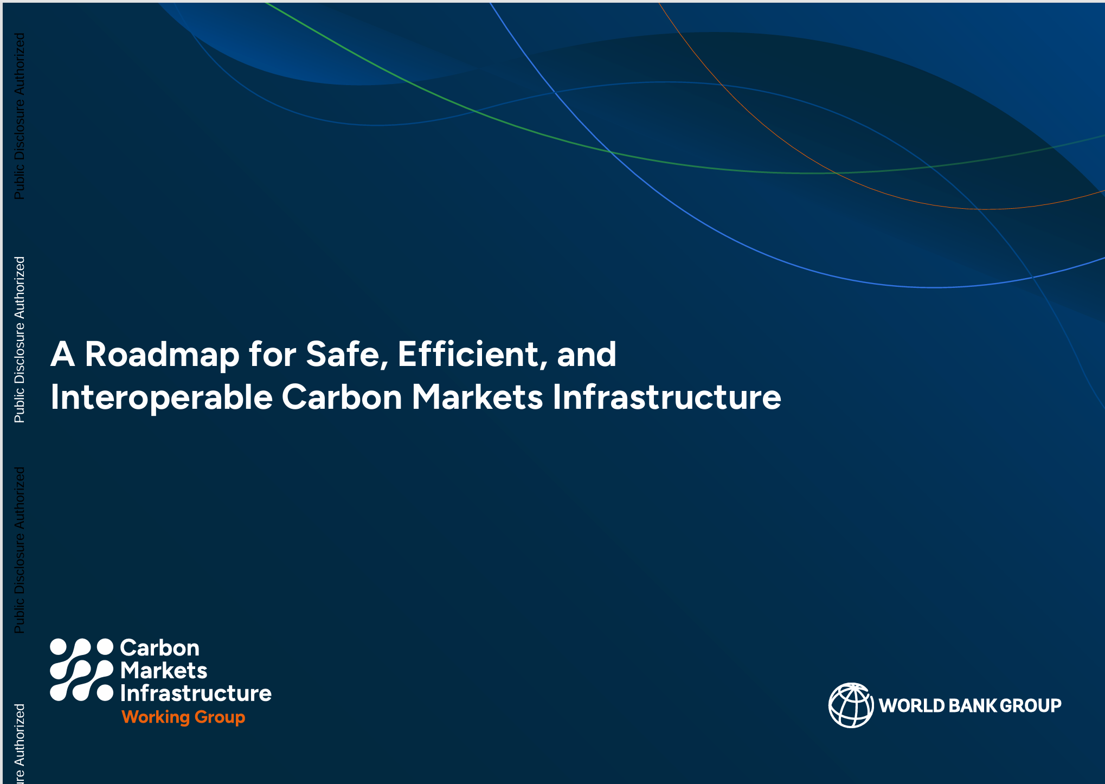

Slide 20
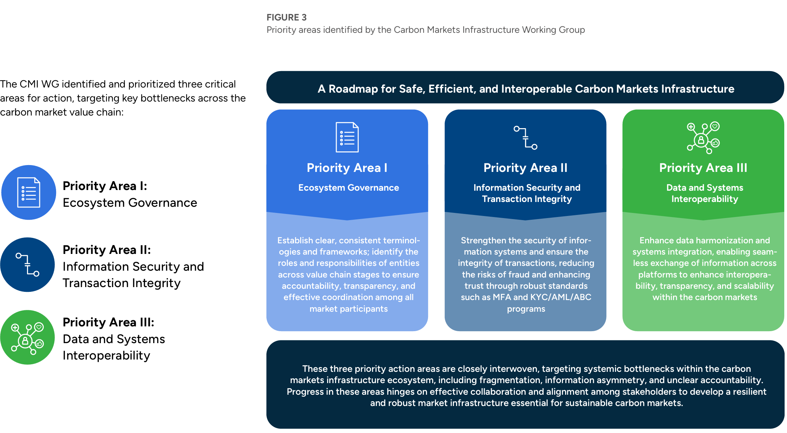


Slide 21
Supply Side Case Examples
CASE | Description
US CFTC: CQC Impact Investors and senior execs | False or misleading data to carbon registries and investors Project cooking systems and LED lightbulbs in Africa, Asia and Central America Fraudulently generated over issuance of 6m carbon credits and raised $250m in an equity Non‑executive directors voluntarily reported to federal law enforcement, regulators and carbon registry | Wire fraud, commodities fraud, securities fraud and conspiracy to commit those offenses $1 million fine Agreed to a number of compliance undertakings and to invalidate all fraudulent carbon offsets
Brazil: Public Defender's Office of the State of Pará four lawsuits against developers four different projects | Project established in violation of the right to traditional territory, with FPIC Non-compliance with legislation on payments for environmental services and public forest concessions | Illegal carbon credit projects - land grabbing
Columbia: Defendants: Developers and the Indigenous authority of “Gran Cumbal” | Project implementation in violation of FPIC, Failure to comply with obligations of free, prior and informed consultation | Found against Defendants Temporary injunction against the REDD+ project and the carbon credit contract and ordered the defendants to conduct FPIC
Kenya​ | Community leaders in Kenya have filed appeals challenging a landmark court ruling, which found that Northern Rangelands Trust had unlawfully established conservancies without obtaining free, prior, and informed consent from local residents.​
Peru​ | In December, the Puerto Franco Kichwa were awarded rights to titles for their traditional lands, threatening the Cordillera Azul REDD project. The developer formally submitted its appeal arguments in defence of the management of the REDD+ project in the national park.​

Slide 22
Market Activity Case Examples
Mis selling
32 companies marketing voluntary carbon credits > £30 million lost by over 2000 investors Selling for up to an 869% profit Bold, exaggerated claims about the financial advantages of buying carbon credits | UK High Court Insolvency | Ordered into compulsory liquidation on grounds of public interest Disqualification of directors
London-based company sold carbon credits to the public however, incapable of operating as the company has no office facilities | UK FCA and High Court | Ordered into compulsory liquidation on grounds of public interest Disqualification of directors
High pressure sales tactics to convince victims to purchase credits that were essentially worthless. Sold on the basis they were good investments but, in reality, there was no market for investors to sell them on and no realistic likelihood of there ever being one. Victims offered ‘exit strategy’ for their investments, but only on the basis that the investor made a further purchase of VERs to make their ‘portfolio look more desirable to a purchaser’, or a payment for some other commodity | UK Criminal Case | Fraudulent trading and money laundering and sentenced to prison terms of 13 and 6 years
Hedge Fund Operators Defrauded Investors with Carbon Offset Bond Product Material misrepresentations of fact including multiple collateralisation of the same digital asset Misappropriated funds Failed to register as a commodity pool operator (CPO) and committed CPO fraud | US CFTC | Ordered restitution in the amount of customer losses (more than $85 million) and ordered disgorgement of collected commissions (almost $37 million)

Slide 23
Demand Side Case Examples
Type | Description
Net Zero Pathways and corporate commitments | Australasian Centre for Corporate Responsibility on behalf of shareholders sued Santos Misrepresentations that it provides clean energy and has a plan for net zero emissions by 2040 are in violation of Australian consumer protection and corporation laws.
 | UK Advertising standards - Equinor, Shell, Petronas, Airlines and travel companies, Banks, Fifia. Positive climate claims were likely to mislead.
 | UK, Australia, multinational. Airlines, Banks, energy companies. Statements about efforts to reduce and/or offset climate impacts are in breach of OECD Guidelines on responsible business conduct
 | New Zealand Z Energy Ltd, petroleum retailer statements do not align its actual policies and actions
Product Attributes - "climate neutral" "total peace of mind" "Fly sustainably" "Zero emissions" on cars | Environmental attributes of a particular product, packaging, or service 13 in Germany on a range of consumer products including food, cleaning products, financial products. labelling the product as ‘climate neutral’ left consumers with the impression that the production and distribution occurred entirely without GHG emissions. UK through the ASA food and drink.
Climate Risk Deception seeks to hold fossil fuel companies accountable for downplaying the impacts of climate change | France TotalEnergies’ shareholders sued for unlawful dividends and insincere accounts. Claim that TotalEnergies has erroneously valuated the future price of carbon and has not properly accounted for its GHGs emissions and that this has led to an overevaluation of its assets.
 | Australia AGL's Demerger Booklet provided inadequate disclosure for shareholders to make a fairly informed decision in exercising their vote on whether or not to support the demerger.
 | California against Exxon, Shell, BP, Conoco, Chevron over their role in climate change

Slide 24
International Court of Justice Advisory Opinion
Qs | 1. What are the obligations of States under international law to ensure the protection of the climate system and other parts of the environment from anthropogenic emissions of GHGs for States and for present and future generations? 2. What are the legal consequences under these obligations for States where they by their acts and omissions, have caused significant harm to the climate system and other parts of the environment, with respect to: States, including in particular small island developing States, which due to their geographical circumstances and level of development, are injured or specially affected by or are particularly vulnerable to the adverse effects of climate change? Peoples and individuals of the present and future generations affected by the adverse effects of climate change?

Slide 25
A1 | Countries have binding obligations under the UN climate treaties but also under general international law, with further obligations arising under human rights law and from other treaties; Includes States (US) that are not a party to the international climate treaties. Duty to ensure protection of the climate system Duty to prevent significant harm to the environment Duty to cooperate with each other Recognises a human right to clean, healthy and sustainable environment All states have a duty of care towards all states and individuals or groups, not just a duty of developed countries Breach of the duty – standard of care must use all means at their disposal (subjective) PA give binding obligations to mitigate and adapt, 1.5ºC is agreed goal, countries obliged to put forward highest possible ambition to make adequate contribution Examples of breach Failing to set out or implement NDC Failing to sufficiently regulate emissions Must use all means at their disposal to prevent or control activities carried out within their jurisdiction from causing significant harm
A 2 | Consequences of breaches Causation attribution and apportionment of responsibility are to be resolved on a case by case basis, attribution to any organ of the state (expressly failure to regulate or control: fossil fuel production, consumption, exploration licenses and subsidies may constitute wrongful act) Is scientifically possible to tie climate damage to specific sources historic and current Consequences – rectification, restitution, specific performance, reparations including compensation for loss and damage

Slide 26
Qs?

Slide 27
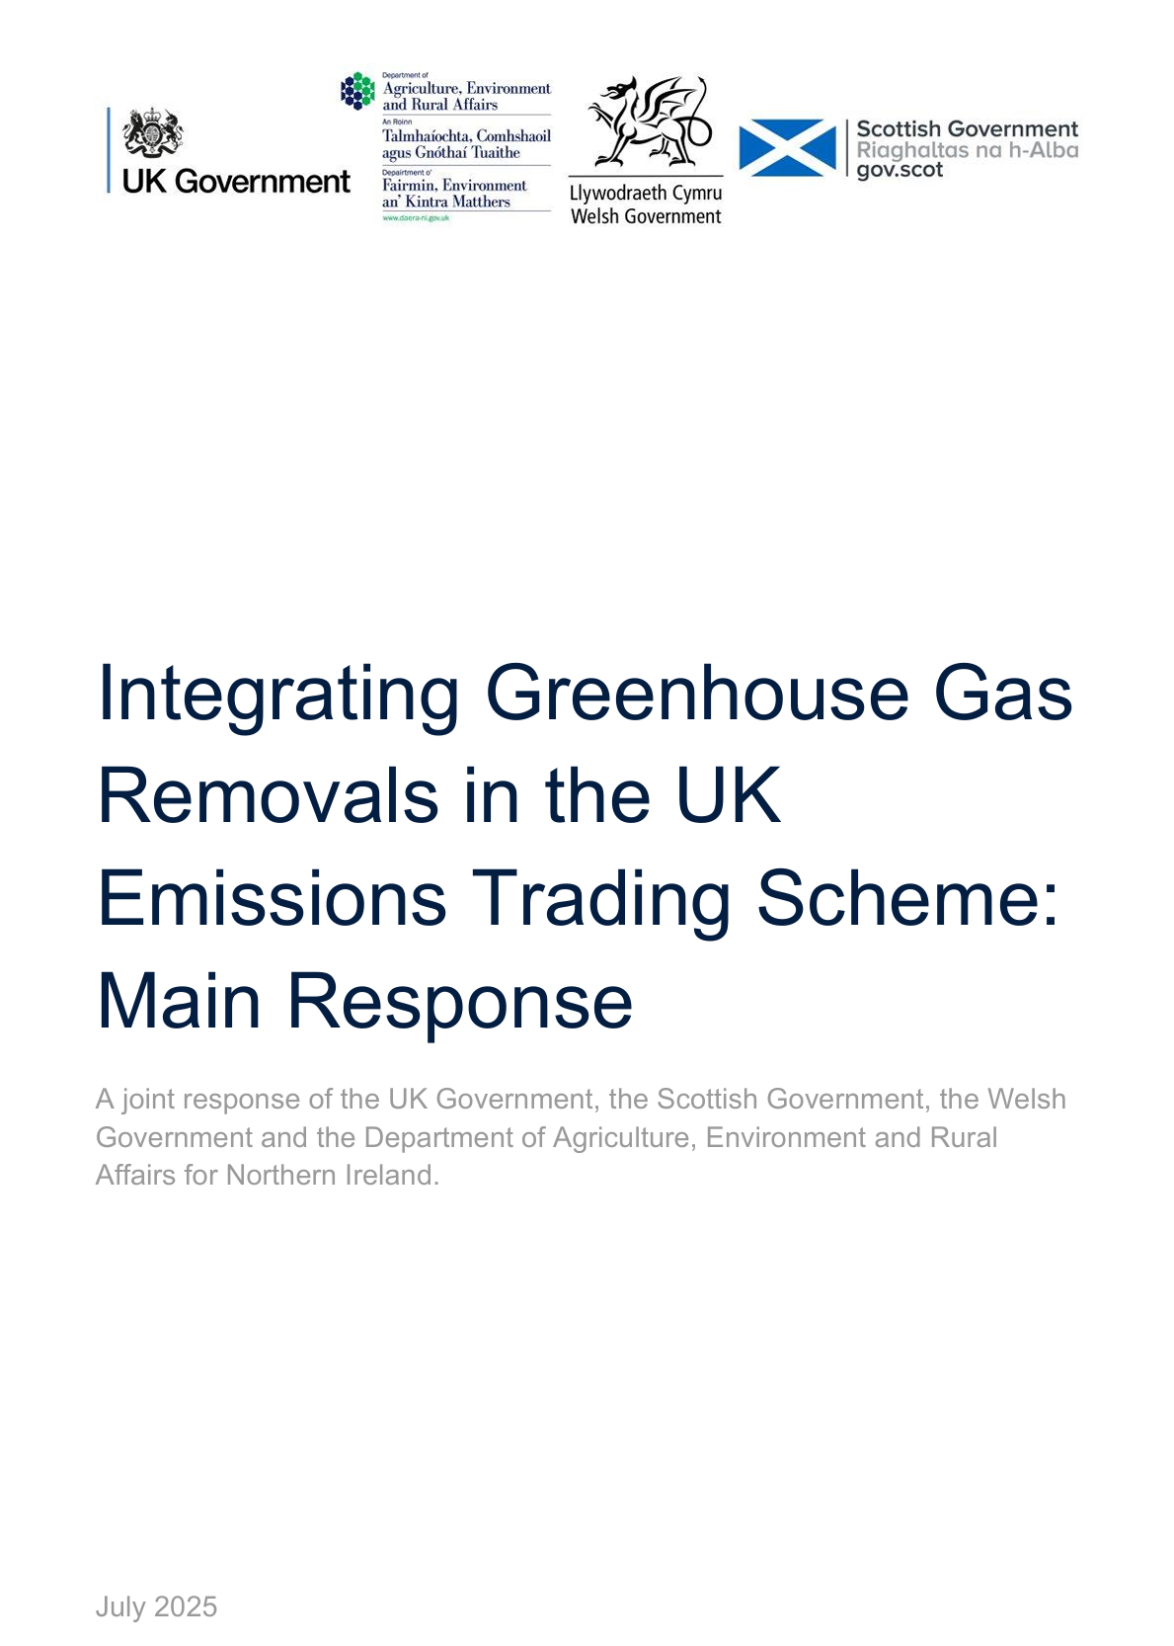
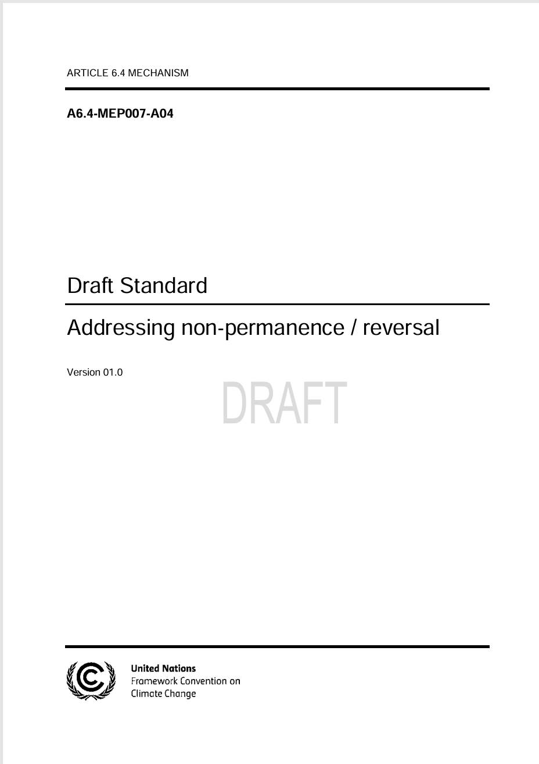


Examples
UK Government
Aim to integrate removals in the UK ETS by the end of 2028
Maintain the gross cap for initial integration of removals into the UK ETS
UK removal allowances will be awarded to GGR operators after carbon sequestration has taken place and been verified
Article 6.4 Methodological Expert Panel Meeting (7-11 July, Bonn): ​
Meeting Report
Upcoming Meetings: ​
4-8 August 2025: SBM 017​
1-5 September 2025: MEP 008
Permanence framework - a minimum storage period for removals, liability measures and fungibility measures
Demonstrate a minimum carbon storage period for carbon of 200 years
Auctions to facilitate a route to market for GGR operators
Only removals that have taken place in the UK will be eligible to receive UK ETS allowances for initial integration
High-quality UK Woodland removals – under consideration
Draft Act Feeback open until 22 September 2025
This initiative establishes methodologies to certify carbon removal activities in which CO2 captured from the atmosphere is permanently stored. These activities are related to:
direct air carbon capture and storage (DACCS)
biogenic carbon capture and storage
(BioCCS)
biochar production

