Slide 1
integrating considerations from Fijian land legislation into carbon markets development
Carbon markets webinar series
Second Workshop: Strengthening Legal Frameworks for Equitable and Sustainable Carbon Credit Implementation.
03 July, 2025

Slide 2
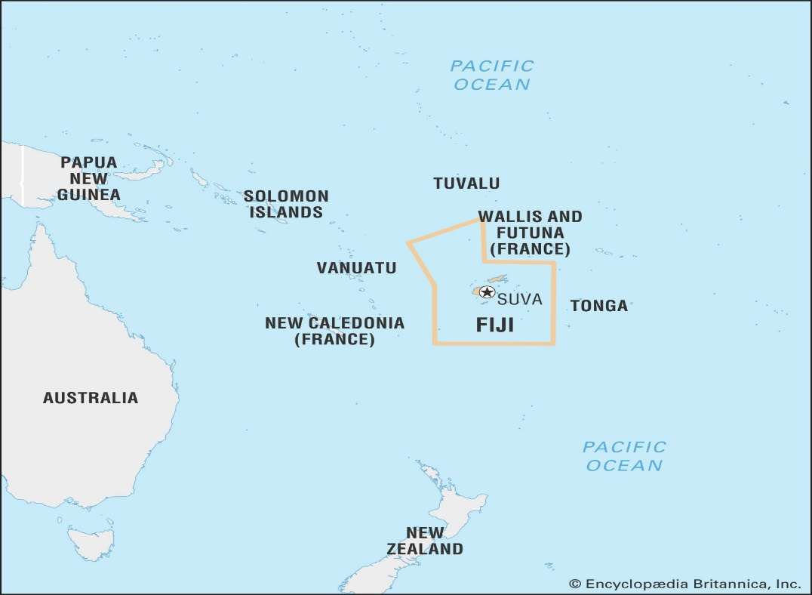
FIJI
Located approximately in the South Pacific Ocean, east of Australia and about northeast of New Zealand. Fiji is an archipelago with approximately more than 300 islands with a population of just below a million.
A former British colony gaining independence in 1970. Fiji is very rich and diverse in culture and religion, the population comprising of indigenous Fijians, Rotuman's, Fijians with Indian, Chinese European descents and other Pacific Islanders who have migrated to Fiji.

Slide 3
Land Tenure in Fiji
Land Tenure in Fiji
Freehold
Approx 6%
iTaukei Land
Approx 90%
State Land
Approx 4%
The ownership of land in Fiji, whether absolute or qualified, is based upon well settled law or custom. Every inch of land in Fiji has an owner, whether by the State, freehold or by itaukei (indigenous) land owners. Every parcel or tract of land has a name and the boundaries are defined and well known.
*iTuakei: is a word in the Fijian vernacular to describe “indigenous”

Slide 4
Pre - Cession
Ownership of land was absolutely in the land owning unit and so the right of ownership over land was absolute and indestructible, land was transferred amongst tribes through some form of custom and in return for military services, dowry or any other service.
Changes brought about by European settlers and Missionaries was one of the major push factors that led to the formal handover of Fiji to Great Britain – Deed of Cession on 10th October 1874.

Slide 5
Deed of Cession
With the signing, it was official, Fiji became a British Crown Colony.
Clause 4 of the Deed of Cession 1874:
“That the absolute proprietorship of all lands not shown to be alienated so as to become bona fide the property of Europeans or other foreigners or not in the actual use or occupation of some chief or tribe or not actually required for the probable future support and maintenance of some chief or tribe shall be and is hereby declared to be vested in her Majesty, her heirs and successors.”

Slide 6
Lands Claims Commission
Governor Sir Arthur Gordon at the time had to determine the land that were bought by early settlers to be able to account for land available to the indigenous population.
The Land Claims Ordinance of 1876 gave rise to the Lands Claims Commission that investigated all land claims and endorsed the issue of Freehold Land titles known as Crown Grants.
The proceedings of the Land Claims Commission took about six years so that by 1882, Sir Gordon, despite opposition from all quarters, was ready to confer the remainder of all land in Fiji to indigenous Fijians under the 1882 Native Lands Ordinance, later known as the Native Lands Act of 1905 and currently known as the iTaukei Lands Act of 1905.

Slide 7
Lands Claims Commission
Land not claimed to be Freehold or iTaukei owned became vested in the Crown by virtue of the iTaukei Lands Act and were known as Vacant or Schedule B lands.
Some lands were also found to have been owned by landowning units which have become extinct and these also became vested in the Crown by ultimus haeres and are known as Schedule A lands.
The Commission’s work was vital in the preservation of iTaukei land and documentation of iTaukei land ownership and boundaries, which resulted in the creation of the iTaukei Register of Land or Vola ni Kawa Bula.
The Commission is now known as the iTaukei Lands and Fisheries Commission, which continues to maintain the iTaukei Register of Land and also investigates and resolves disputes or claims related to land or fisheries ownership.

Slide 8
Land Administration
There are two land administration systems in place in Fiji.
The system that:
records and maintains iTaukei land; and
maintains and records freehold land, state land and leases and iTaukei leases.

Slide 9
iTaukei Land
iTaukei Land Trust Board (iTLTB)
iTLTB was established under the iTaukei Land Trust Act 1940 to oversee, control and administer iTaukei land leases on behalf of the iTaukei landowners.
iTLTB also keep the records of iTaukei land and works with the iTaukei Lands and Fisheries Commission to ensure that records relating to iTaukei land and iTaukei land owners are maintained and that correct land owning units are engaged should any iTaukei land be utilized.

Slide 10
iTaukei Land
iTLTB being the legal trustee on behalf of all indigenous land owning units becomes the lessor for any iTaukei land that is leased.
iTLTB administers:
The manner in which iTaukei land is leased, license, or utilized;
Takes the necessary steps working with the Ministry of iTaukei Affairs and iTaukei Land and Fisheries Commission to identify the correct land owning unit that owns the iTaukei land that is required to be utilized;
Takes the necessary steps to consult the land owning unit to obtain the necessary consent (60% of adults) for the utilization of their land;

Slide 11
iTaukei Land
Negotiates on behalf of the land owning unit the conditions of leasing and compensation to be paid to the land owners for the utilization of their land;
Takes the necessary steps to register the lease or license; and
Administer the lease, lease payments and disbursements of lease payments or any other compensation as directed by the land owners and/or distributes payments to the bank account of each land owner that are registered with iTLTB.
Lease payments or any other compensation belonging to land owners under the age of 18 are securely kept by iTLTB until the land owner reaches the age of 18 at which time it is distributed to the land owner. TLTB also invests these funds on behalf of minors and any dividends are paid to the land owner upon attaining the age of 18.
iTLTB website, https://tltb.com.fj/ for any further information about iTLTB.

Slide 12
Freehold Land, State Leases & iTaukei Leases
Fiji adopted the Torrens Title System of registration, which is utilized to maintain a separate register for freehold land, state leases iTaukei Leases.
This system is created under Land Transfer Act 1970 and maintained by the Registrar of Titles under the Ministry of Justice.
This system is searchable and provides information about the current proprietor of land registered with this Registry as well as historical dealings.

Slide 13
The Structure: TLFC
The Ministry of iTaukei Affairs
Tasked with looking after itaukei affairs and iTaukei people, which includes, language, culture, land, and fisheries.
A Division within the Ministry of iTaukei Affairs that tasked with maintaining the register of iTaukei land owners, confirmation of traditional customary titles, land boundaries, fishing ground boundaries, investigate cases of challenges to customary titles and land/fishing ground boundaries.
Division:
iTaukei Lands & Fisheries Commission
All new births of iTaukei persons are not only registered with the Births Deaths, Marriages Registry, but also registered in the Vola ni Kawa Bula (iTaukei Land Register) maintained with the iTaukei Lands & Fisheries Commission
iTaukei people/land owning groups

Slide 14
The Structure: iTLTB
TLFC
TLFC & iTLTB work
Together to ensure land owner information and consultations are conducted for leasing arrangements.
The iTakei Land Trust Act 1940
Establishes the iTaukei Land Trust Board.
The iTLTB as the trustee of all land owning units in Fiji is managed by a Board of Trustees and is mandated to administer iTaukei land for leasing that is not being used by iTaukei land owners for their own use and maintenance. iTLTB works with TFLC to ensure land owners are consulted.
iTaukei Land Trust Board
Registrar of Titles
TLTB attends to the registration of Leases of iTaukei Land with the Registrar of Titles
iTLTB ensures that land rent or compensation of any leasing arrangement made by the iTLTB is distributed equally between all iTaukei land owning units.
iTaukei people/land owning groups

Slide 15
Leasing Arrangements
TLTB negotiates and administers the leasing arrangements on behalf of the land owning units, including compensation, which includes assessment of:
of premiums for new leases or renewal of leases;
land rent and rent review period;
Other compensation like, education funds, village maintenance fund and any other types of monetary contributions negotiated between iTLTB and the intending Lessee in consultation with the land owning units;
Other benefits may include conditions to employ land owners from the land owning units, involvement in the entity lessee via joint venture arrangement or part of the board of directors.

Slide 16
Fiji Carbon Markets
The Climate Change Act 2021 (“CCA”) provides the legal framework that will enable the carbon markets to operate within Fiji.
The Regulations to operationalize the Part 10 of the CCA, that is “Carbon Sequestration Property Rights and Emissions Reduction Projects, Programmes and Activities” are currently in draft form.
The existing legal frame work and institutions that administers land management, consent processes, distribution of compensation to resources owners will be beneficial in administering similar processes required in the carbon markets and under the draft CCA Regulations .

