Slide 1
Case-study: EIA legislation:
Port City project

Slide 2
Part 1
Environmental Impact Assessment

Slide 3
environmental Impact Assessment
predict the environmental consequences
Problems
natural resource constraints
measures to minimise
projects environmentally sustainable

Slide 4
Legislature
The National Environmental Act
introduced the EIA procedure into the statute
And applies where there’s an overlap
The Coast Conservation Act
The Fauna and Flora Protection Ordinance
The National Environmental Act
The Coast Conservation Act
limited to coasts
The Fauna and Flora Protection Ordinance
limited to areas close to national reserves

Slide 5
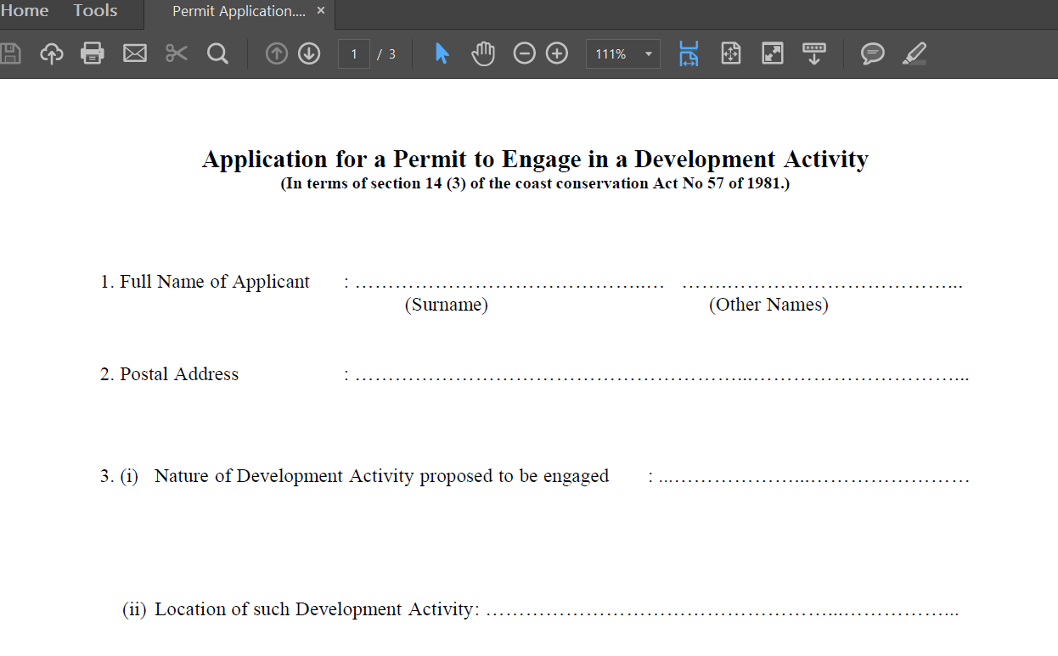
The Coast Conservation Act (CCA)
Permit Procedure
development activity within the coastal zone
Permit from Director of Coast Conservation
Minister may prescribe activities which don’t require a permit
Can require an environmental impact assessment report to be furnished
Published by Gazette
Public Comment within 30 days
Decision

Slide 6
The National Environmental Act
introduced detailed EIA procedure
Minister specifies Project Approving Agencies
Minister specifies the prescribed projects
initial environmental examination report or environmental impact assessment report required
published for public comment (30 days)
National Environmental (Procedure for Approval of Projects) Regulations (1993)

Slide 7
National Environmental (Procedure for Approval of Projects) Regulations
Preliminary information must be submitted as early as possible to the Project Approving Authority
Environmental Scoping – Authority subjects this info to scoping to prepare Terms of Reference for IEE /EIA
IEE/EIA- defined by the Act
Once EIA/IEE is carried out – published for public participation (30 days)
Public hearings may be allowed – if in the “public interest”
Ex; highly controversial / unusual national or regional impacts etc
Project Approving Agencies – Ministries
list of projects set out which require EIA -3 parts
1. “Projects and undertakings if located wholly or partly outside the coastal zone as defined by the Coast Conservation Act”
2. industries have been identified by name but not by magnitude or size
Iron and Steel/Pesticides and Fertilizer etc.
3. environmentally sensitive areas
archaeological reserve/100 metres wildlife sanctuary etc.,
After public participation the approving authority in consultation with the Central Environmental Authority will either grant/or refuse approval
Can impose conditions
Appeals process
If there are alterations to the project – they may require fresh approvals

Slide 8
Impact Assessment
National Environmental Act defines an IEE
written report
possible impacts assessed
“significant impacts”
(not defined)
National Environmental Act defines an EIA
written analysis
environmental cost benefit analysis
description of the project
alternatives - reasonably available ex: Natural Resources Defence Council v. Morton
description of any irreversible or irretrievable commitments of resources
Significant Impacts
subjective judgment
Context
Intensity
Cumulative Impacts

Slide 9
international level
Rio Declaration
environmental impact assessment, as a national instrument, shall be undertaken for proposed activities that are likely to have a significant adverse impact on the environment and are subject to a decision of a competent national authority.
New Zealand v. France
Weeramantry J. –
The principle is gathering strength and international acceptance, and has reached the level of general recognition at which this Court should take notice of it

Slide 10
PART 2 Colombo Port City
SC (F/R). No- 151/2015

Slide 11
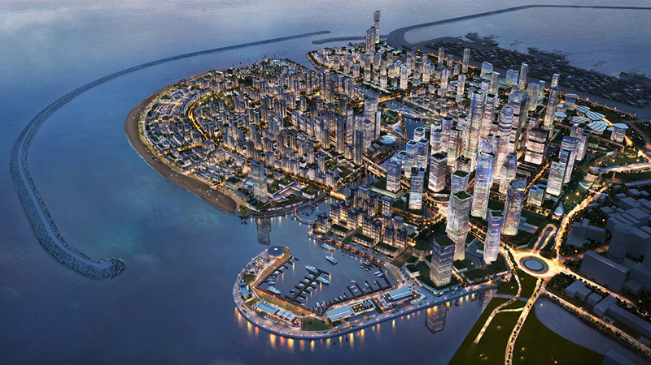
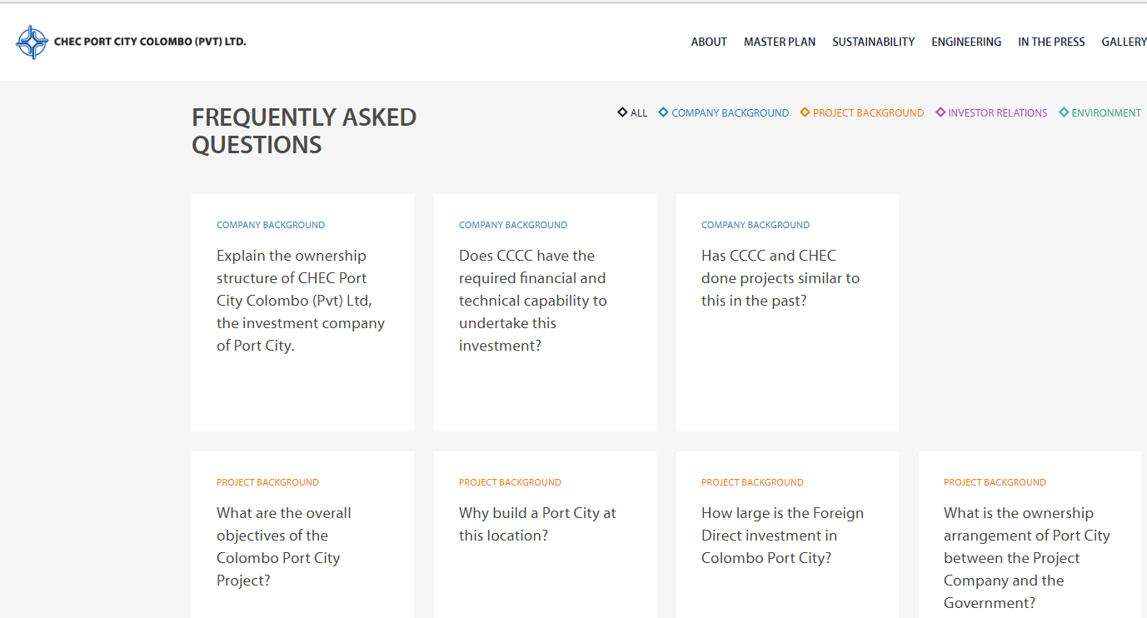
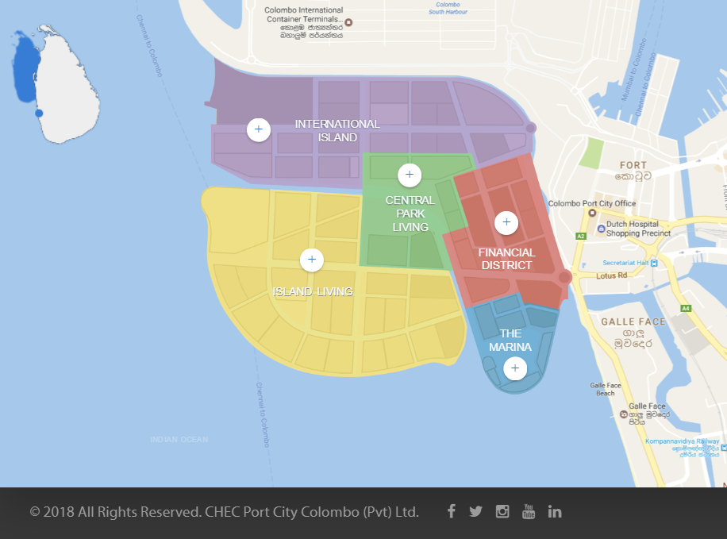
PORT CITY

Slide 12
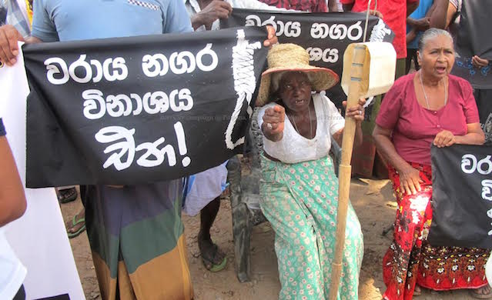
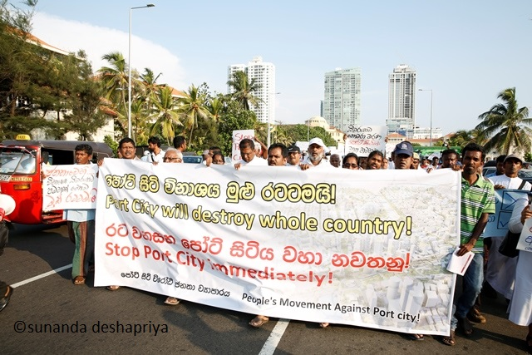
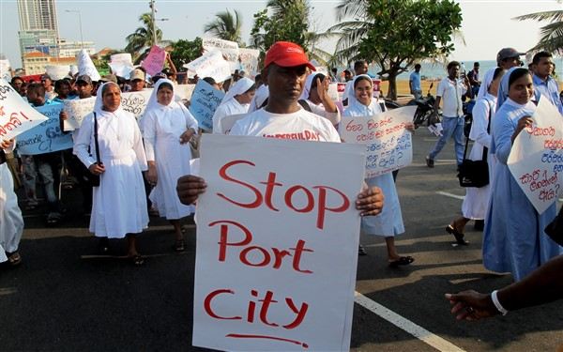
PROTESTS

Slide 13
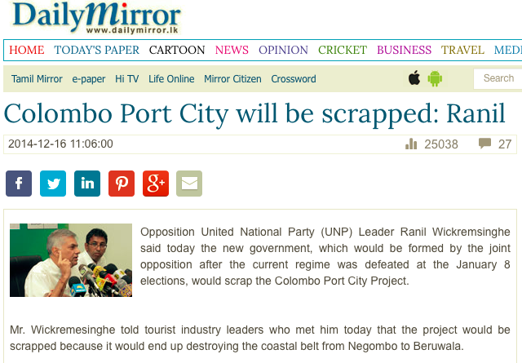
FILING LEGAL ACTION
Difficulties finding a petitioner
All Ceylon Fisher-folk Trade Union
approximately 30,000 fisherfolk living near the sea shore between areas adversely affected by mining for sand
Public Interest Litigation –

Slide 14
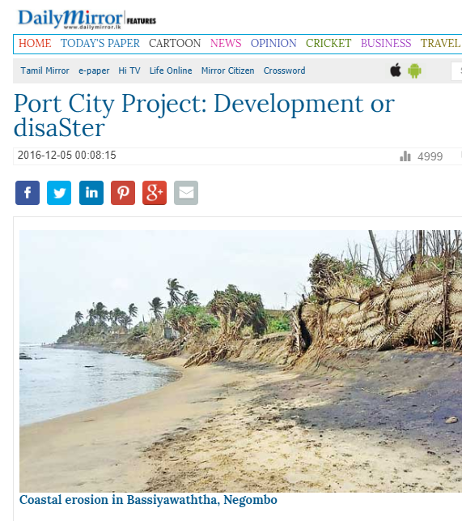
Fundamental rights action filed April 2015
Practical problems of lack of information
media publications and news items
EIA had apparently been done
reclaim approximately 120 ha. of land
project was expanded in scope
land reclamation of approximately 233 ha
no fresh EIA was carried out., only an Addendum to the original EIA was carried out by the University of Moratuwa
Could not trace any permit issued
Main Arguments
SAND MINING
beach has started to disappear due to erosion
destruction of the coral reef
murky waters
three (3) main areas in which fish procreate in large numbers and are thus conducive for fishing
2. LACK OF PROPER EIA
EIA had been carried out for 120 ha
No fresh EIA when project increased to 233 ha
(only an addendum)
3. CHINA COMMUNICATION CONSTRUCTION COMPANY LTD

Slide 15
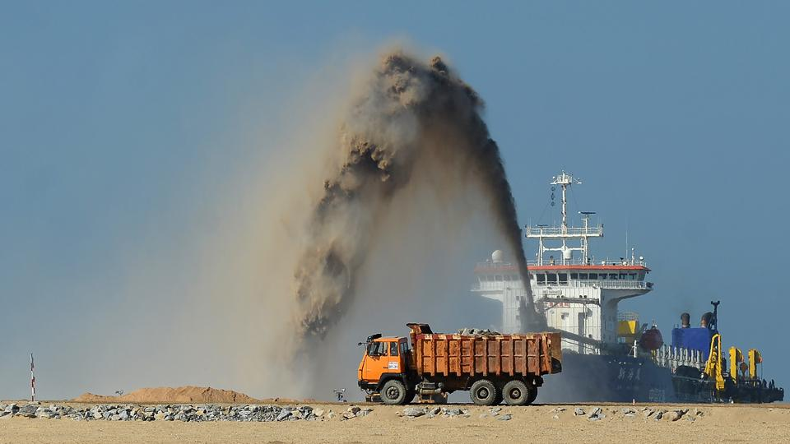
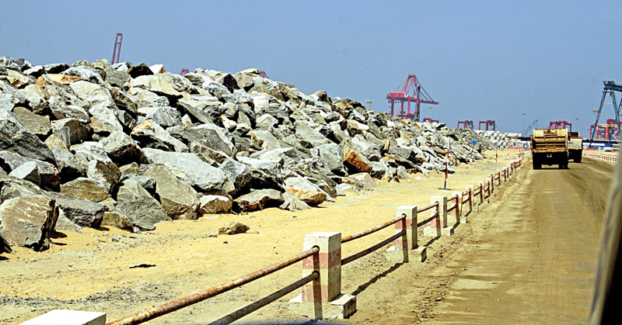
Reliefs sought
The Initial Technical Feasibility Study;
Any Impact Assessment carried out in respect of the original development project;
a copy of the project proposal;
preliminary approval granted for the original project by the CCD;
Permit issued for a Development;
all relevant contingency plans drawn up,
the relevant EIA and/or IEE and/or any environment study carried out,
the relevant permission issued by the Road Development Authority to transport quarry material
Industrial Mining Licence
The contract entered into by the State for the Colombo Port City Development Project;
Meanwhile
3 km breakwater was being constructed
3.6 million cubic meters of rock
Three hundred six-wheelers
Dredging

Slide 16
Access to environmental information
No Right to Information Act
Rio Declaration - each individual shall have appropriate access to information concerning the environment that is held by public authorities
Agenda 21 access to information relevant to environment and development
Europe – EC Directive on Access to Environmental Info
OSPAR Convention
make available information on the state of the maritime area on activities adversely affecting or likely to affect it.
Aarhus Convention
ensure that public authorities make available access to information relating to the environment
WWF UK v Commission & Bavarian Lager Co. v Commission,
all exceptions to public access to information must be narrowly construed
Anna Maria Guerra v Italy
ECHR did NOT exclude positive obligations

Slide 17
2016 amended petition
The Attorney-General’s Department provided several key documents
IEE/EIA/Addendum/Supplementary EIA
Very limited time
Petitioners’ retained experts; Emeritus Professor Department of Geography University of Sri Jayewardenepura, Marine Biologists etc.,
“Agreement between the Secretary to the Ministry of Highways, Ports and Shipping and CHEC Port City Colombo (Pvt) Limited (September 2014)”
condition precedent – amend existing Law
THE AREAS AFFECTED
land reclamation
sand mining
quarry materials
Transport

Slide 18
SANDMINING
IEE (2012) - 30 million m³
2 sites surveyed- total Extractable Volume is only 44.31 million m³
Supplementary EIA (December 2015), 65 million m³
two dredging sites - available sand is estimated at 112 million m³
doubt as to even the extent of the land to be reclaimed
Initial Technical Feasibility Study (August 2010) - 80 hectares
Environmental Impact Assessment Study (April 2011) - 120 hectares
addendum in 2013 - 200 Hectares
Supplementary EIA (December 2015) - 269 hectares

Slide 19
Quarry Materials
Supplementary EIA - 3.45 million m³
No mention of the quantities of explosive materials/explosive times, vibration etc.,
Impact on communities ?
supplies for local and national requirement ?
historical value - rock shelter monasteries etc.?

Slide 20
SOME ARGUMENTS
1. ABSENCE OF ADEQUATE ENVIRONMENTAL ASSESSMENT STUDIES
No comprehensive EIA
EIAs ignored
size of the development- which keeps morphing /other developments
use of natural resources/ production of waste
EIA’s themselves refer to permits they “hope will be obtained”
No monitoring mechanism discussed
Adequate alternatives not discussed
original EIA (April 2011), was required by its Terms of Reference to consider, the extent of the proposed mining site, estimated reserves, access roads proposed to be used, types of vehicles to be used etc., -not addressed
2. SUSTAINABLE DEVELOPMENT
Rio de Janeiro Declaration (1992)
“the right to development must be fulfilled so as to equitably meet developmental and environmental needs of present and future generations”
“In order to achieve sustainable development, environmental protection shall constitute an integral part of the development process and cannot be considered in isolation from it”
Agreement already signed - Government has undertaken to grant all licences / Amend existing Laws
3.BIAS
a) University - initial EIA and Addendum,
project consultant in the Supplementary EIA
b) only international consultant in the Supplementary EIA
private entity - commissioned by CCCC (or its subsidiary before)
Reviewing its own work?

Slide 21
Environmental protection and human rights
Powell and Rayner v UK
strike a fair balance between the competing interests of the individual and the community
Lopez Ostra v Spain
nuisance and serious health problems – regardless of fulfilling Spanish Laws
Hatton and others v UK
serious attempt to assess / evaluate the extent or impact of the interferences
Proceedings terminated 7th July 2016
subject to recognition that the Petitioner may submit information on how the fishing community would be adversely affected

Slide 22
CONCLUSION
Structure of laws – sufficient?
Poor public participation
(language? Apathy?)
Lack of capacity to carry out EIA?
Lack of political will?

